Slide 1

EDA Project – AMCAT Data Analysis
Submitted by : Gouri Kabra

Slide 2
About Me
Greetings!
My Name is Gouri Kabra. I have done B.Tech in Electronics and Telecommunication Engineering from Shri Guru Gobind Singhji Institute of Engineering and Technology. I am a 2024 batch student.
Why Data Science?
With the increasing reliance on data-driven decision making, I aim to contribute to this field by combining my technical background with data analytics skills.
Work Experience
I have worked as an AI-ML intern at COE @SGGSIE&T, wherein I worked on projects like Retinal fundus image classification to identify potential risk of eye diseases.
Linkedin: https://www.linkedin.com/in/gouri-kabra/
Github: https://github.com/Gouri-Kabra

Slide 3
Problem Statement & Use Case Domain Understanding
Problem Statement:
To perform Exploratory Data Analysis(EDA) on AMCAT Dataset to understand salary trends.
Considering salary as target variable, analyse its relation with other factors which influence salary for graduates.
Use Case Domain:
Education and Employment Market.
Targeting salary predictions, specialization trends, and job designations for fresh graduates.

Slide 4
Objective of the Project
Objective:
Analyse the graduate dataset to find patterns in salary distribution, job roles, gender differences and educational background.
Provide insights to support claims about salary expectations for certain engineering specializations.

Slide 5
Summary of the Dataset
The dataset used for EDA is Aspiring Mind Employment Outcome 2015 (AMEO) Dataset. The study is primarily limited only to students with engineering disciplines. The dataset contains the employment outcomes of engineering graduates as dependent variables (Salary, Job Titles, and Job Locations) along with the standardized scores from three different areas – cognitive skills, technical skills and personality skills.
Total number of records: 3998
Target Variable: Salary
Numerical Columns: 10th percentage, 12th percentage, College GPA, English, Logical, Quant.
Categorical Columns: Designation, Job City, Gender, Degree, Specialization, College State.

Slide 6
Data Cleaning Steps
Removed unnecessary and unnamed columns.
Checked and handled missing/null values and duplicates.
Standardized text in Job City column, corrected misspellings and variations.
Converted all designations to lowercase, standardized abbreviations and corrected common typos.

Slide 7
Data Manipulation Steps
Date Format Standardization:
Converted the DOJ and DOB columns to consistent datetime format.
Handling Dynamic Entries in DOL:
Converted DOL column to datetime where applicable, and left as ‘present’ for ongoing employment.
Capping Outliers in Salary:
Calculated the 99th percentile for the salary column to identify extreme outliers.
Capped salaries above 99th percentile at the calculated value to reduce the impact of outliers without removing data.

Slide 8
Non-Visual Analysis of Target Variable, Salary
Minimum Salary: 35000.0
Maximum Salary: 4000000.0
Mean: 307699.8499249625
Median: 300000.0
Range: 3965000.0
IQR: 190000.0
Standard Deviation: 212737.49995685622
Skewness: 6.451081166224832
Kurtosis: 80.92999627162538

Slide 9
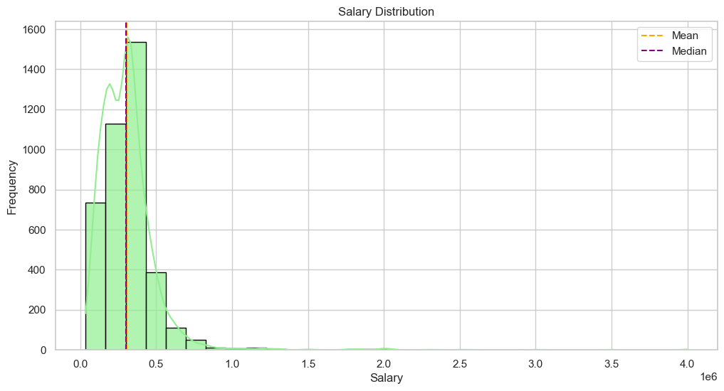
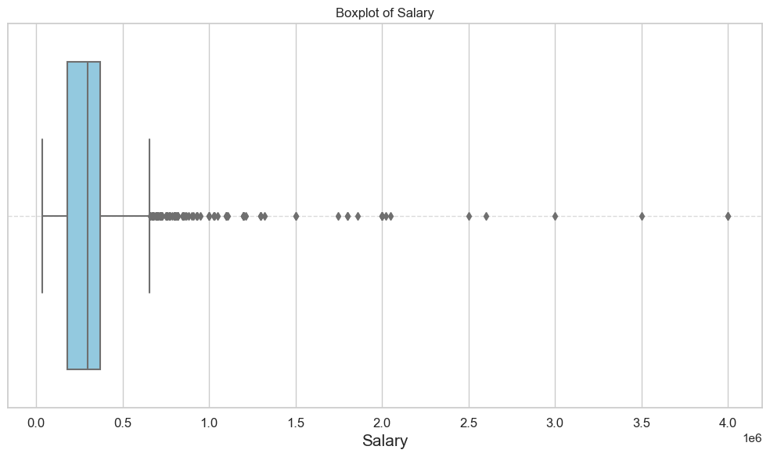
Visual Analysis of Target Variable, Salary
The histogram shows a right-skewed distribution, indicating that most of the salary data points are concentrated in lower range, with a long tail on the right.
Majority of the graduates and post graduates earn below-average salaries, while a few individuals with very high salaries pull the mean higher.
The boxplot shows the salary data distribution, with a clear concentration of data within the lower quartiles. A large number of outliers are present, confirming that many data points are much higher than the majority.
Outliers are visible far beyond the whiskers, representing individuals earning significantly higher salaries.

Slide 10
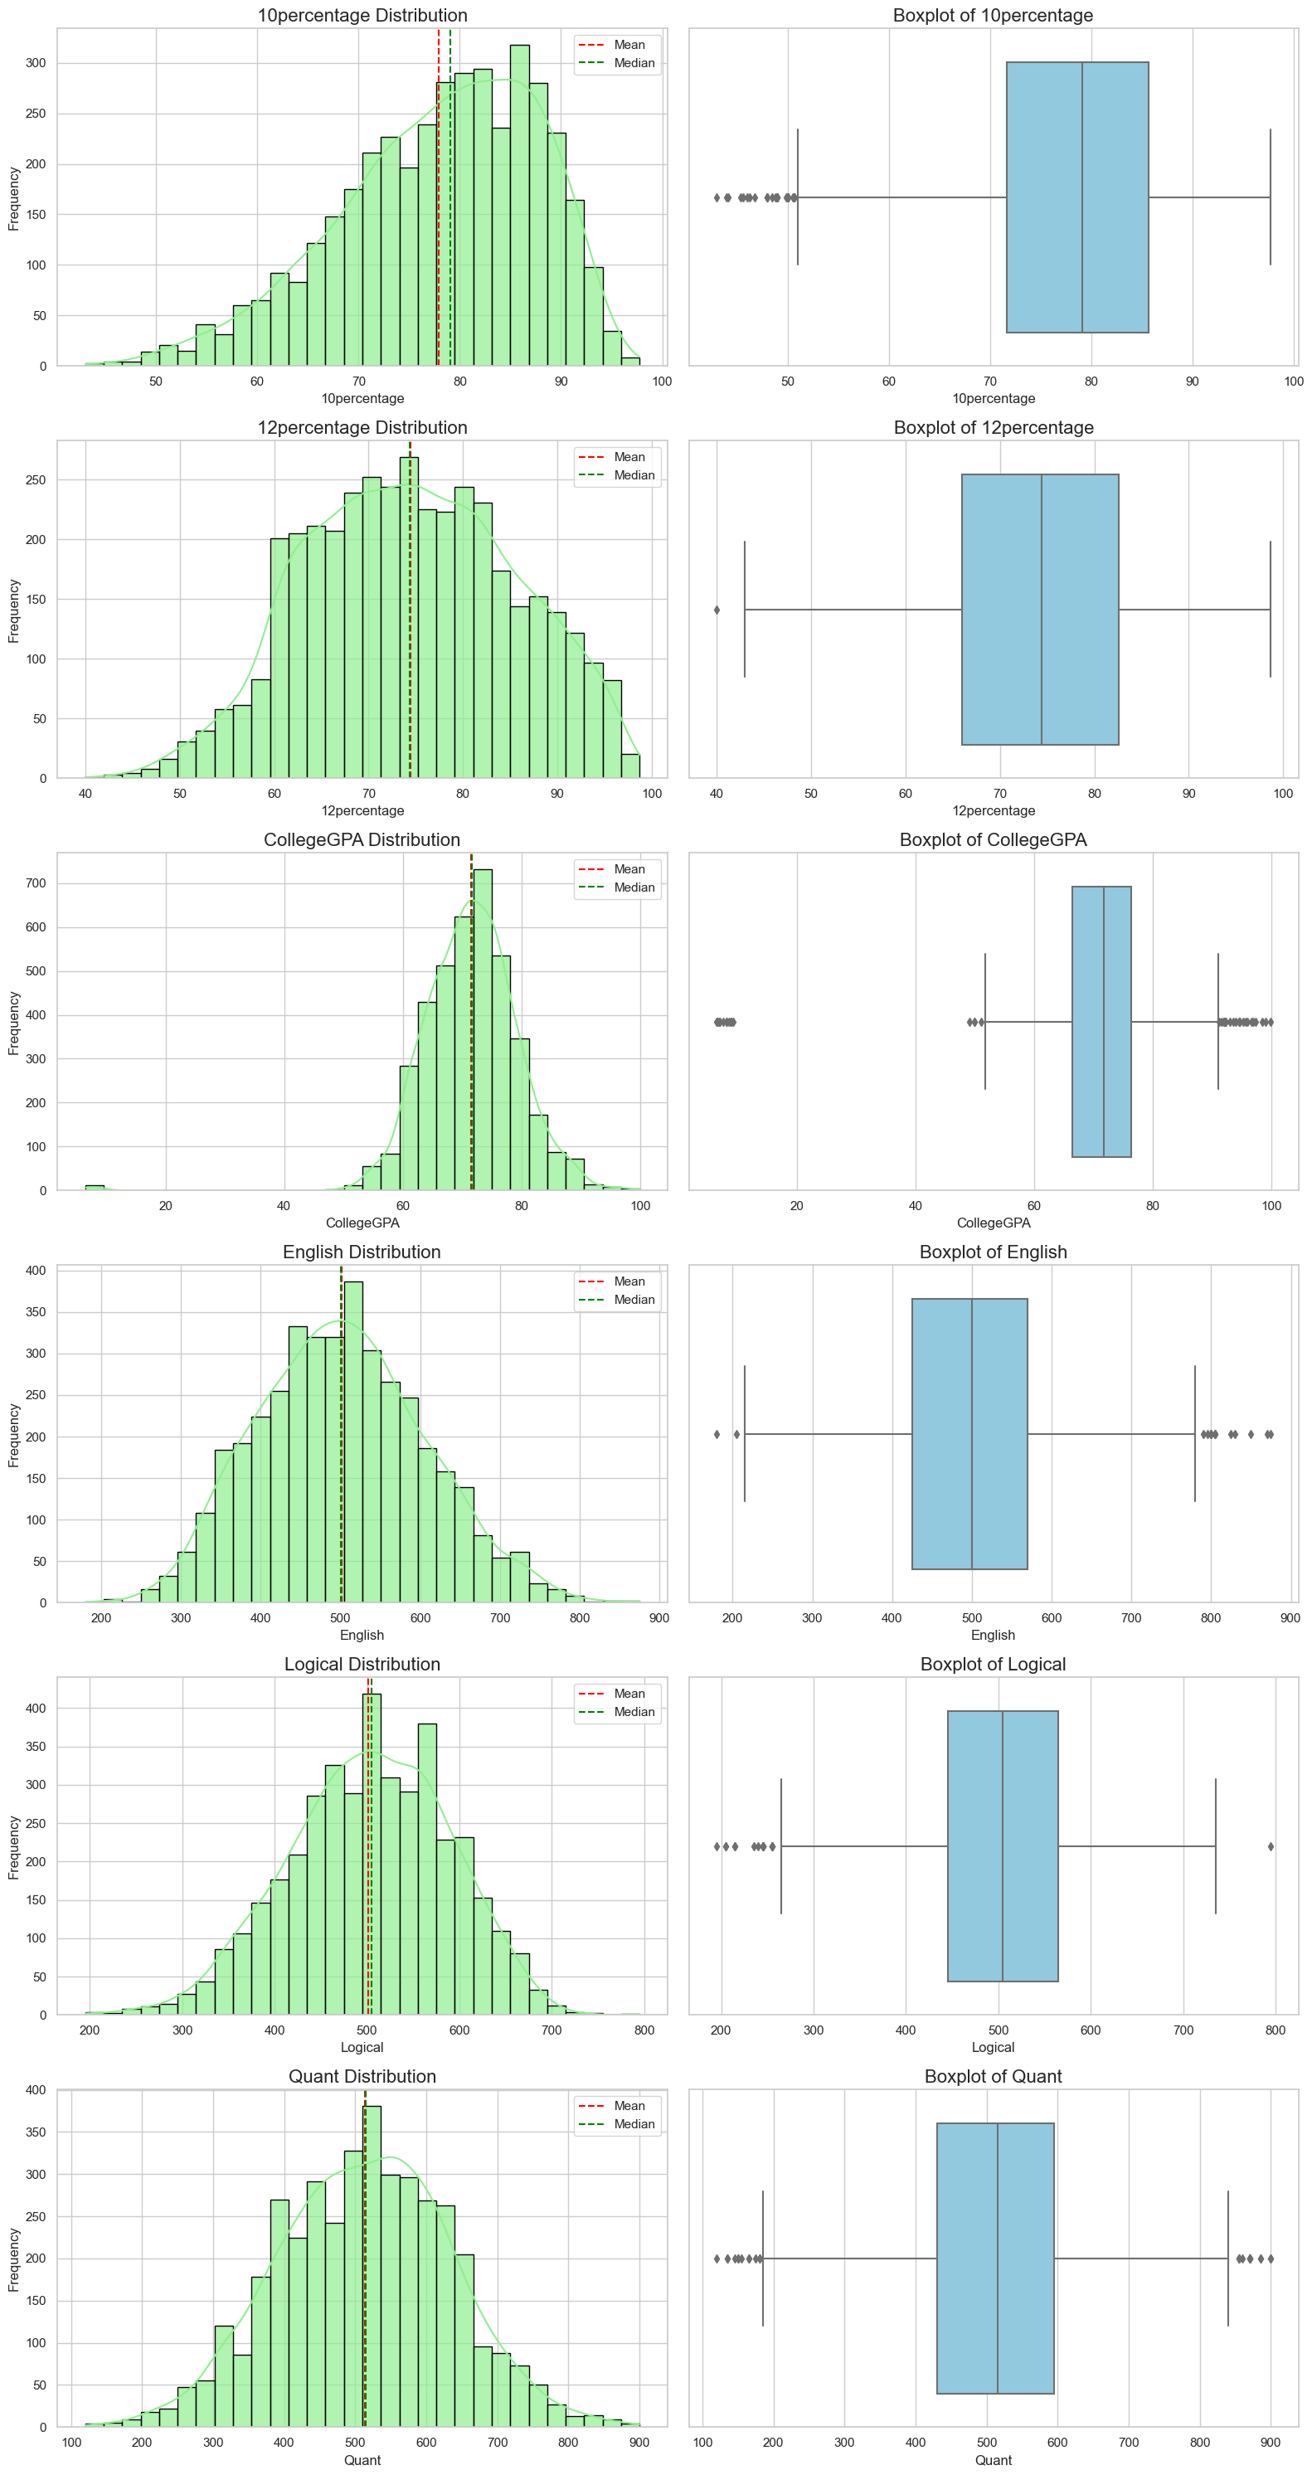
Univariate Analysis of Other Numerical Variables
The distributions(histogram plot) and boxplots suggest that students generally perform within a narrow range for academic scores, while their logical and quantitative scores are more spread out.

Slide 11
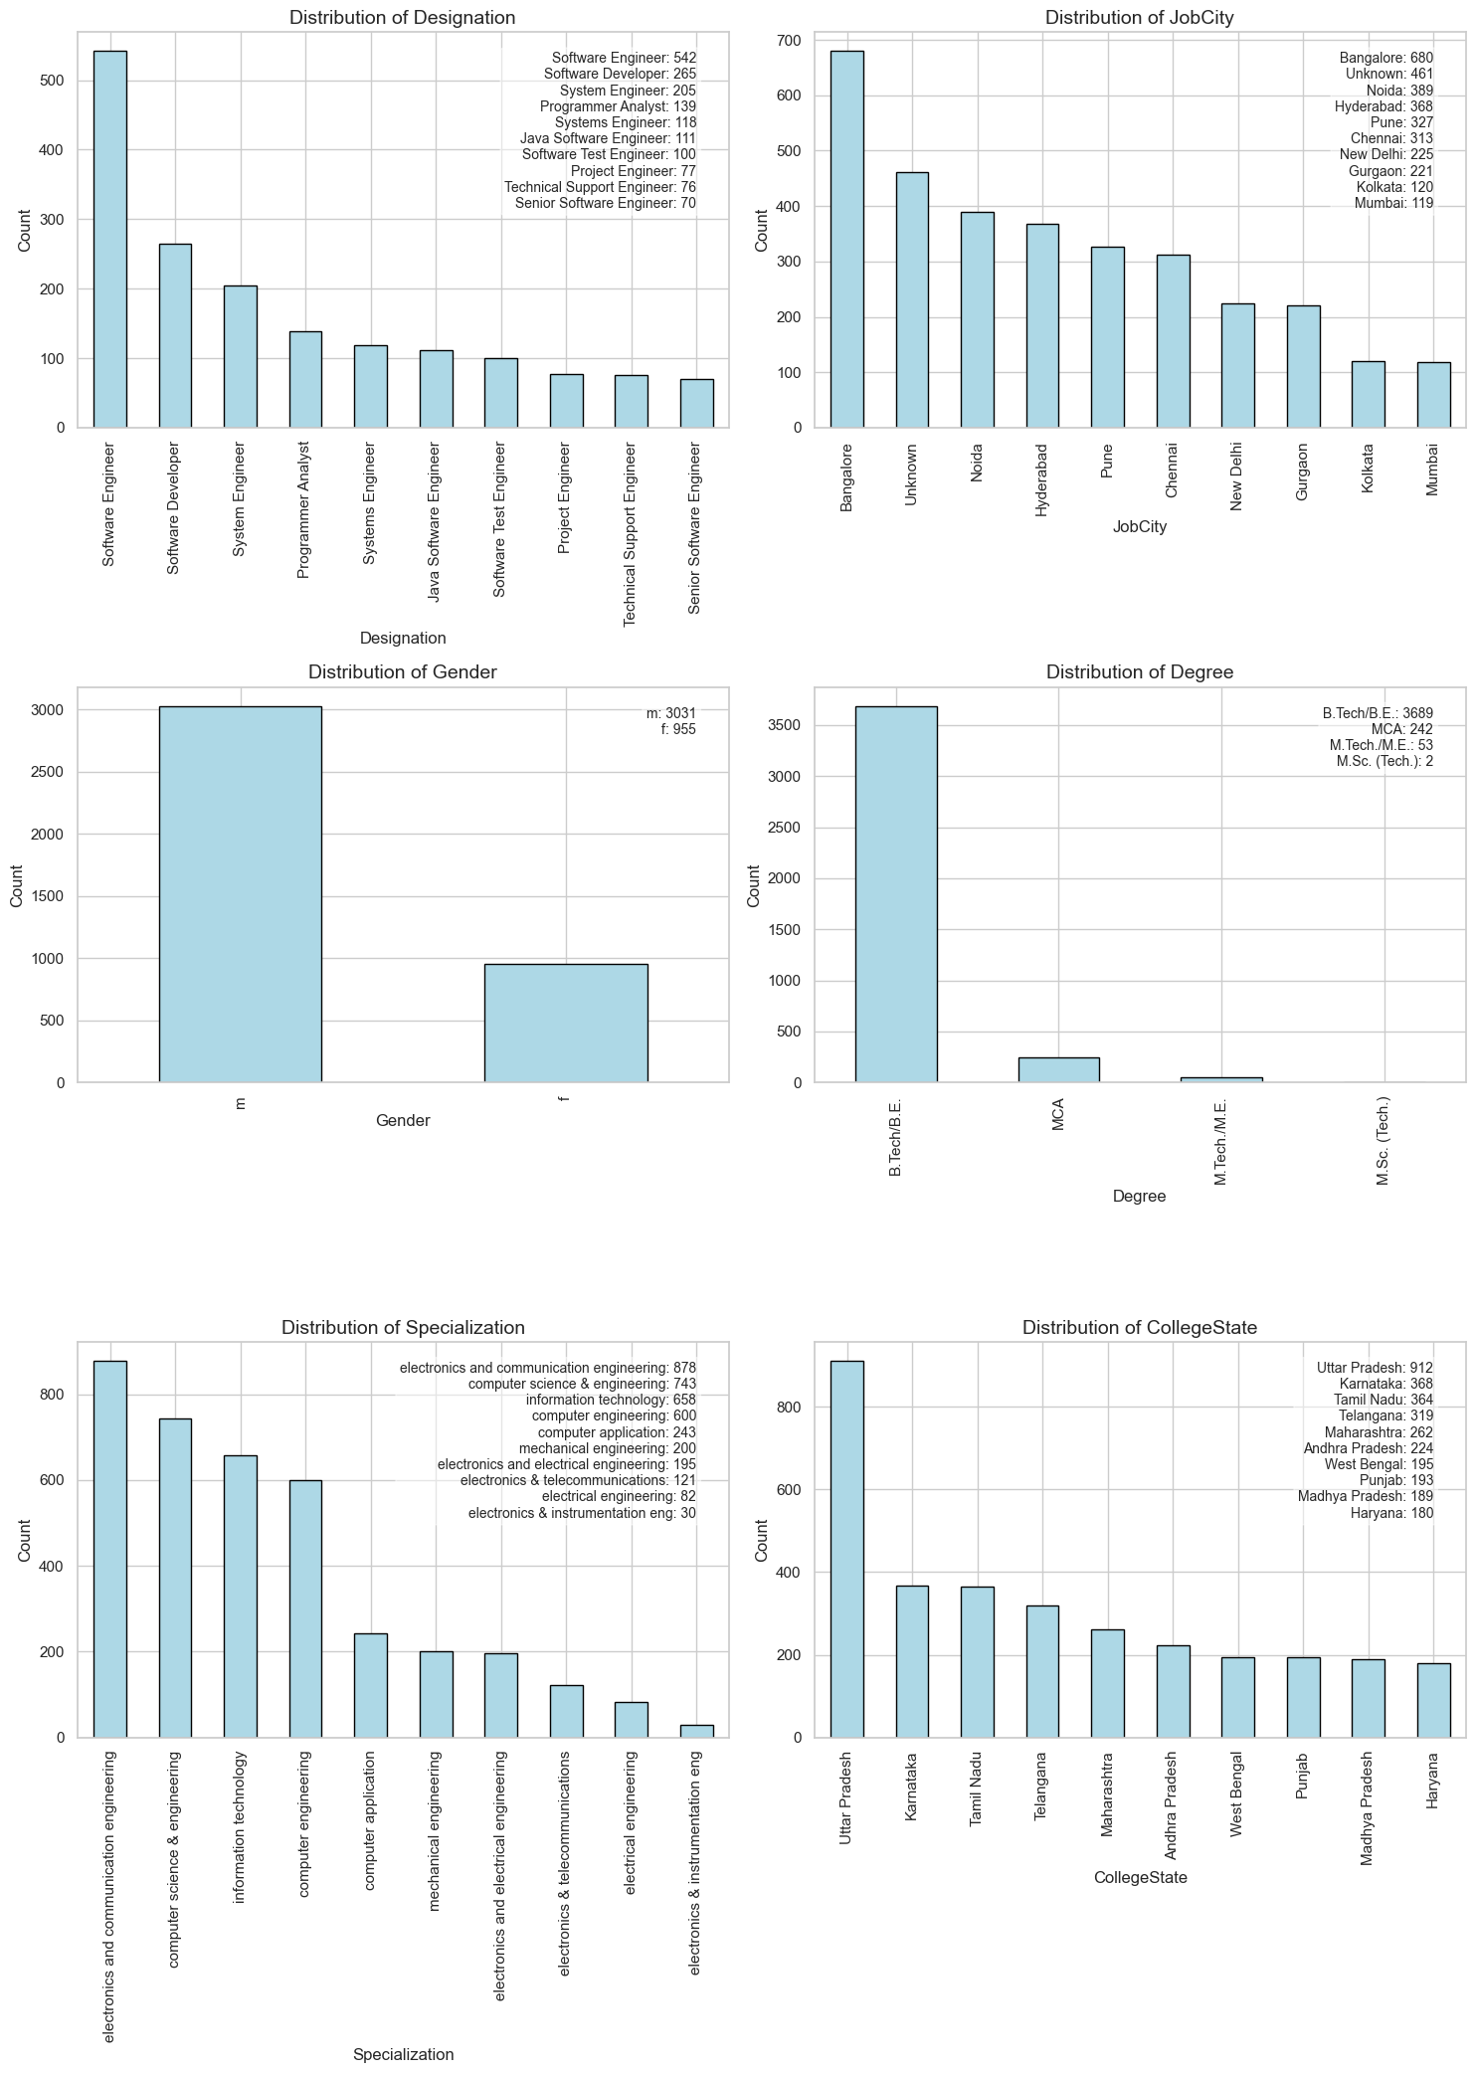
Univariate Analysis of Categorical Variables

Slide 12
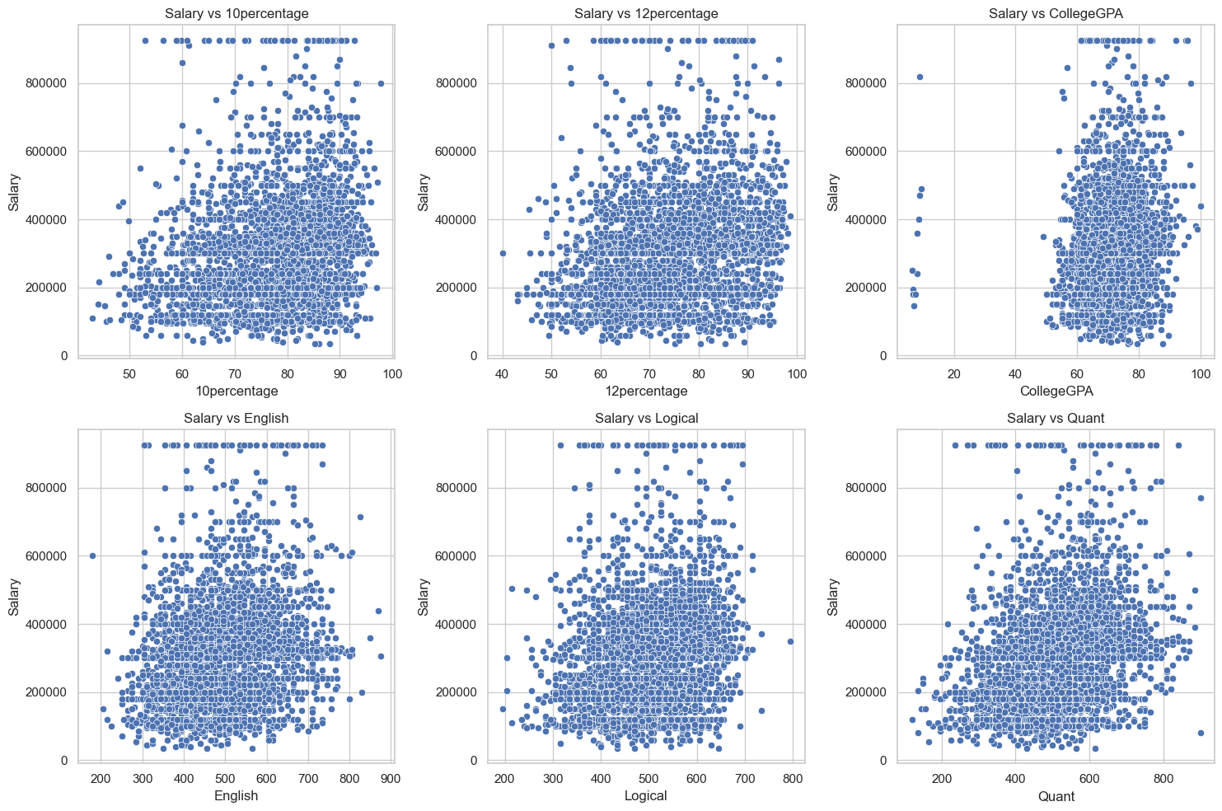
Bivariate Analysis, Salary vs Other Numerical Variables

Slide 13
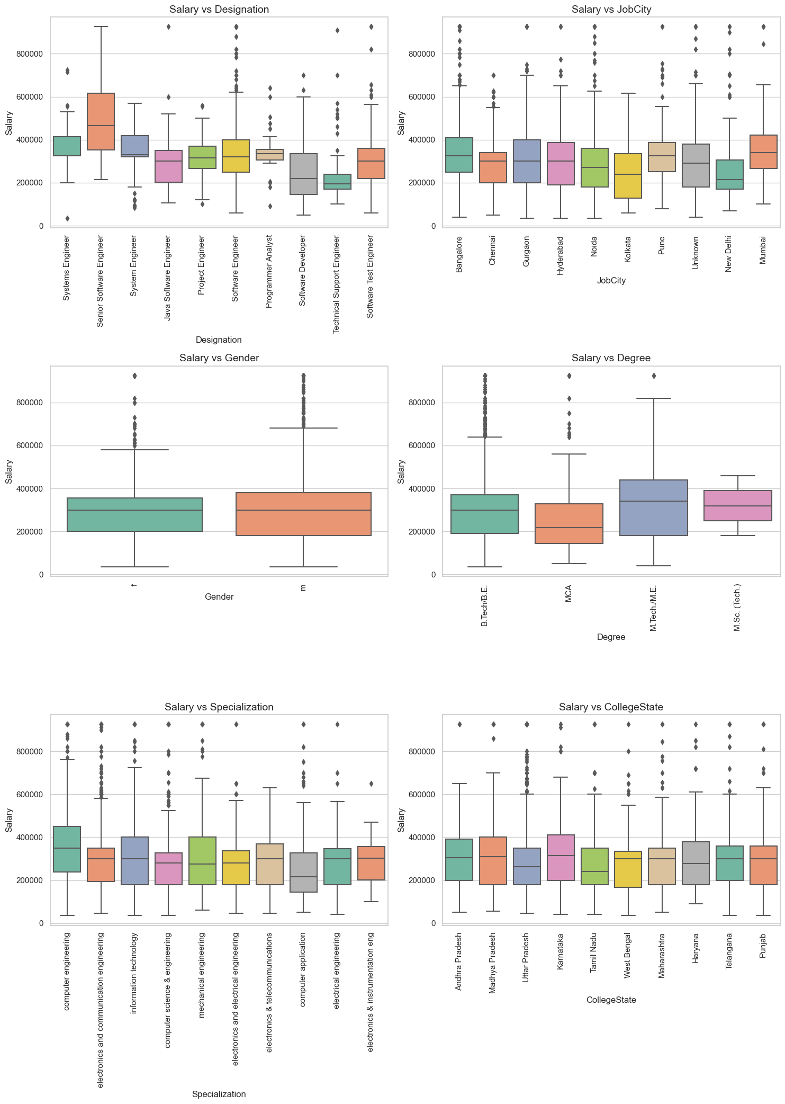
Bivariate Analysis, Salary vs Categorical Variables

Slide 14
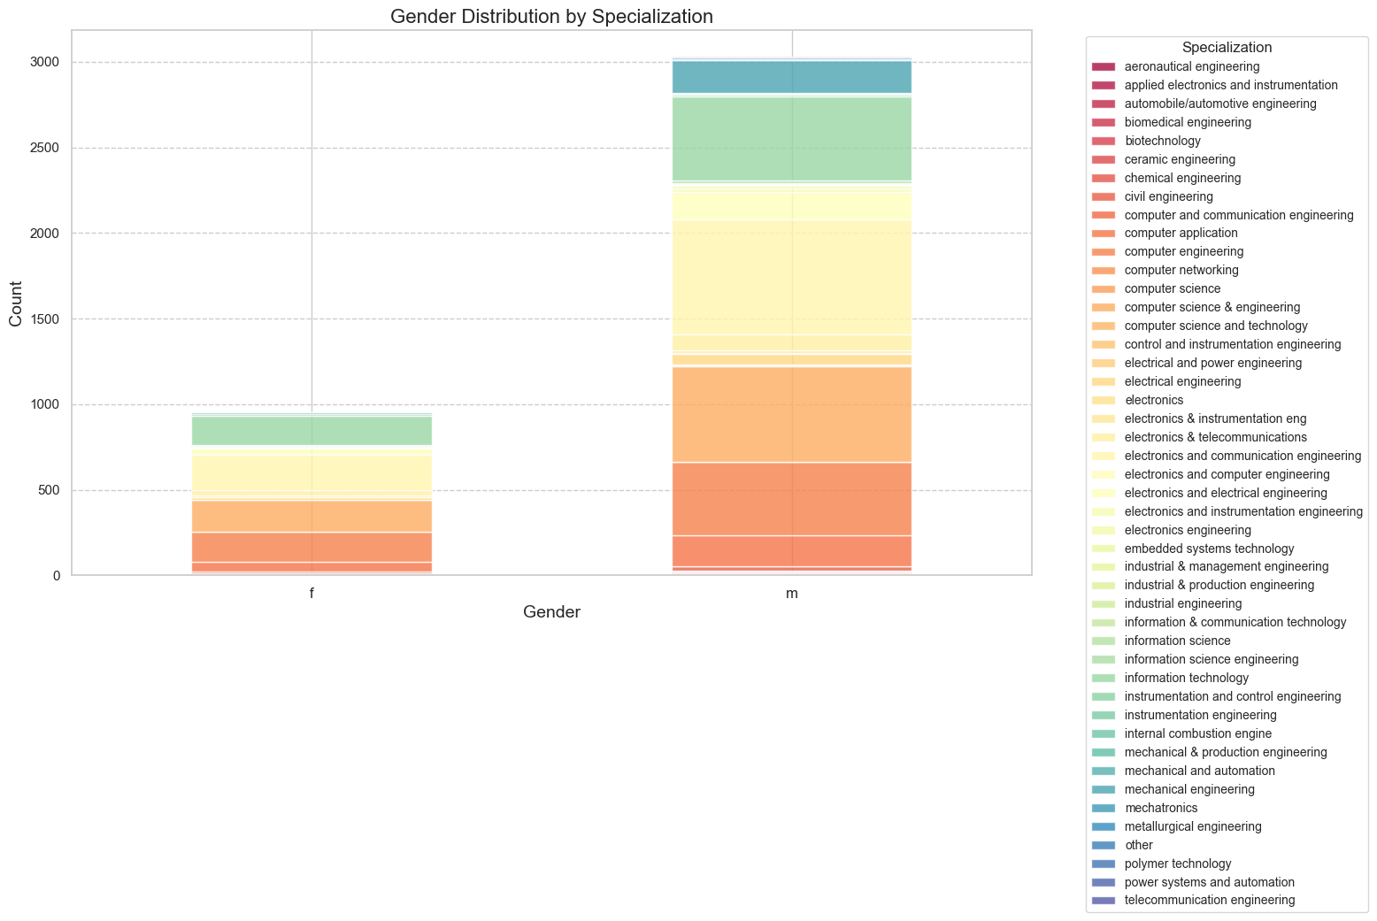
Research Question
The mean salary for fresh B.Tech graduates with Computer Science-related specializations in the Programming Analyst, Software Engineer, Hardware Engineer and Associate Engineer is: 288666.67.
There a relationship between gender and specialization. The overall trend indicates a persistent gender bias in engineering, with women being underrepresented in many areas.
Most Gender-Imbalanced Specializations: Electrical Engineering, Computer Science Engineering, Mechanical Engineering.
Relatively Balanced Specializations: Biomedical Engineering, Chemical Engineering.
Notable Female Representation: Textile Technology, Architecture.

Slide 15
Conclusion
Key Findings:
City Impact: Bangalore dominates in terms of both job frequency and higher salaries.
Designation Matters: Senior roles and more specialized positions offer better salary packages.
Education & Specialization: Higher degrees and specialized engineering fields (like electronics, computer science) are associated with better salaries.
Skills: Academic scores and skill levels (English, Logical, Quant) show some correlation with salary, but they are not the sole determinants.
Salary trends vary significantly by designation, gender, and degree.
Computer Science graduates meet the salary expectations stated by the Times of India article.
There is a relationship between gender and specialization preferences.
Salary discrepancies exist between genders, with males earning higher in some designations.

Slide 16
Challenges and Learnings
Challenges Faced:
Data Cleaning: Handling inconsistency, spelling mistakes and variations in Job City column.
Data Manipulation: Grouping similar specializations and filtering relevant designations.
Visualization: Handling cluttered plots due to the large number of designations and categories.
Learnings:
Gained hands-on experience with pandas, seaborn and matplotlib.
Enhanced skills in handling large datasets and deriving insights from them.

Slide 17

THANK YOU

